Slide 1
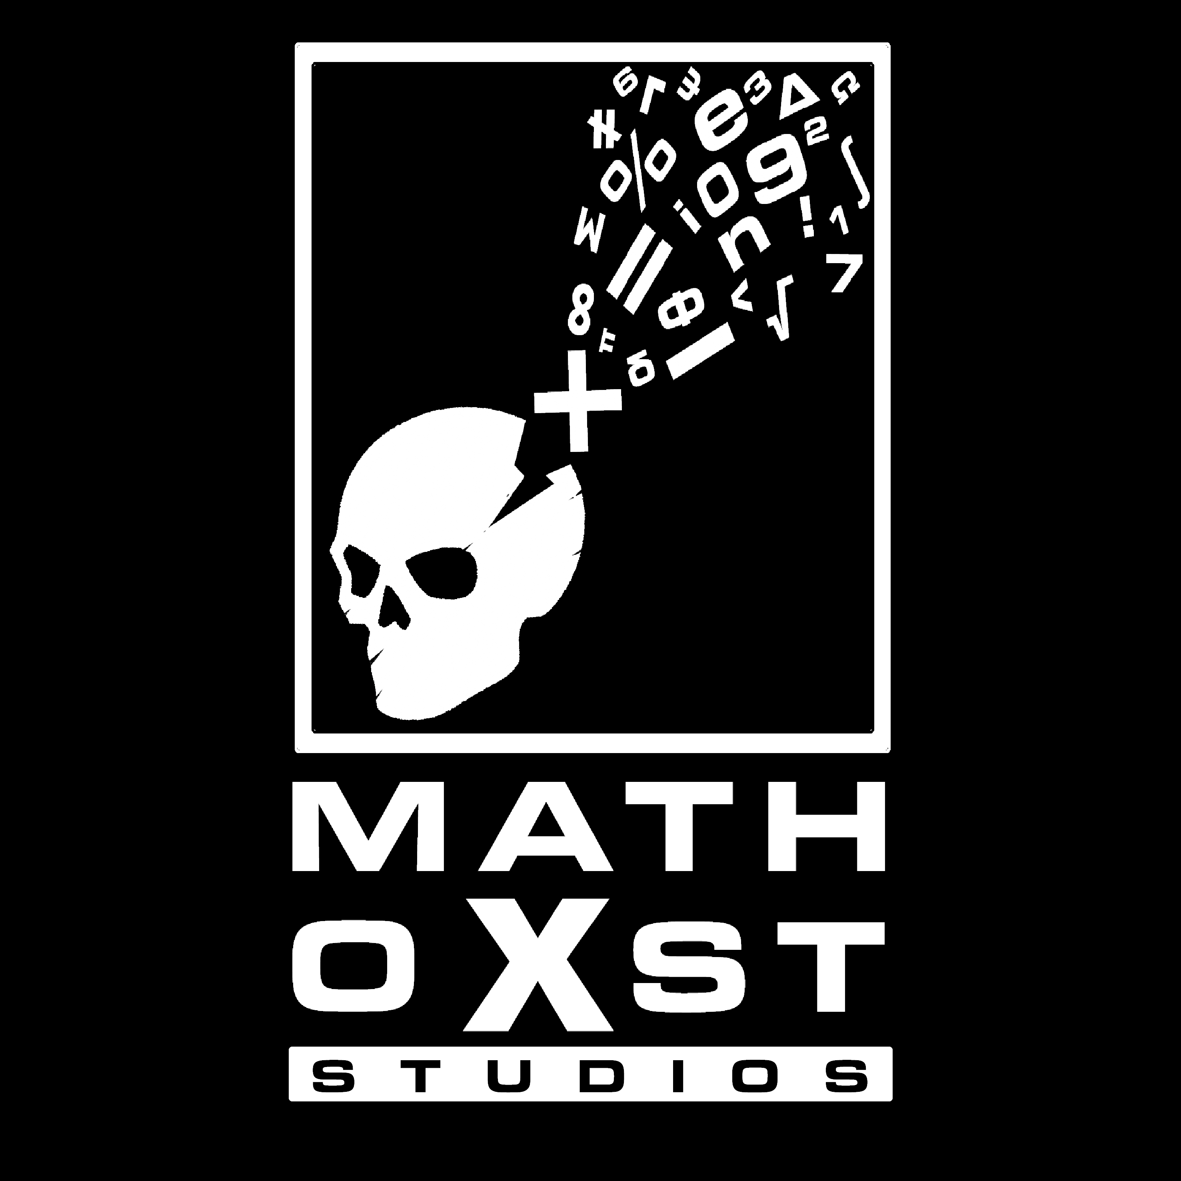
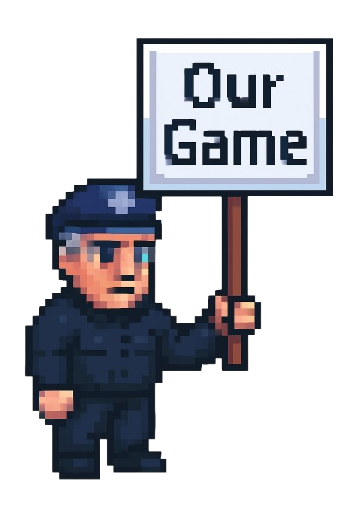


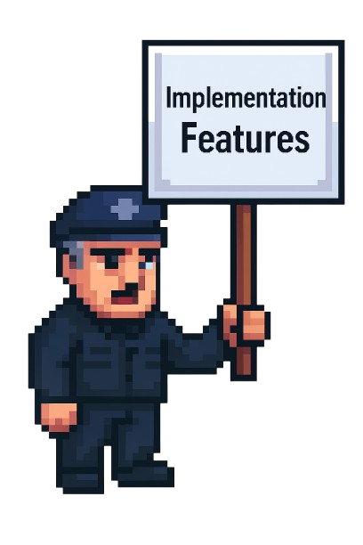


All-Nighter
Josh – Harri – Aiden – Charlie – Zach – Marcus – Euan - Will

Slide 2
Features
Maze game based at night
Easy controls and beginner friendly!
FULLY resizable (I dare you to try break it)
FUN events!
Extra assets for YOU to use
Works on ALL OSes

Slide 3
Our Implementation
Only ONE library used! (LibGDX)
COMPLETE game framework BUILT!
SUPER EXTENSIBLE!
FULL entity tile system
COMPLETELY MODULAR world system

Slide 4
One more thing…

Slide 5

Any Questions?
https://www.mathochiststudios.com

